Slide 1
Chapter 5 Syntax-Directed Translation
Approaches to implement Syntax-Directed Translation
1、Basic idea
  Guided by context-free grammar
  Associate information with a programming language construction by attaching attributes to the grammar symbols representing the construction.
  Values for attributes are computed by “semantic rules ”associated with the grammar productions.

Slide 2
Chapter 5 Syntax-Directed Translation
Approaches to implement Syntax-Directed Translation
2、Two notations for associating semantic rules with productions
  Syntax-directed definitions
    High-level specifications for translations
    Hide implementation details
    No need to specify explicitly the order in which translation take place

Slide 3
Chapter 5 Syntax-Directed Translation
Approaches to implement Syntax-Directed Translation
2、Two notations for associating semantic rules with productions
  Translation schemes
    Indicate the order in which semantic rules are to be evaluated.
    Allow some implementation details to be shown

Slide 4
Chapter 5 Syntax-Directed Translation
Approaches to implement Syntax-Directed Translation
3、Conceptual view of syntax-directed translation
Notes: 1)Evaluation of the semantic rules may generate code, save information in a symbol table , issue error messages, or perform any other activities.
Input
string
Parse
tree
Dependency
graph
Evaluation order
for semantic rules

Slide 5
Chapter 5 Syntax-Directed Translation
Approaches to implement Syntax-Directed Translation
3、Conceptual view of syntax-directed translation
Note: 2) Special cases of syntax-directed definitions can be implemented in a single pass by evaluating semantic rules during parsing, without explicitly constructing a parse tree or a graph showing dependencies between attributes.

Slide 6
Chapter 5 Syntax-Directed Translation
5.1 Syntax-Directed Definitions
1、Definitions
  1)Syntax-directed definition
    A generalization of a context-free grammar in which each grammar symbol has an associated set of attributes

Slide 7
Chapter 5 Syntax-Directed Translation
5.1 Syntax-Directed Definitions
1、Definitions
  2)Attribute
    Represent anything we choose: a string, a number, a type, a memory location, etc.
    Notes: The value of an attribute at a parse-tree node is defined by a semantic rule associated with the production used at that node.

Slide 8
Chapter 5 Syntax-Directed Translation
5.1 Syntax-Directed Definitions
1、Definitions
  3)Types of Attribute
    Synthesized attribute
      The value of a synthesized attribute at a node is computed from the values of attributes at the children of that node in the parse tree
    Inherited attribute
      The value of an inherited attribute is computed from the values of attributes at the siblings and parent of that node.

Slide 9
Chapter 5 Syntax-Directed Translation
5.1 Syntax-Directed Definitions
1、Definitions
  4)Dependency graph
    A graph that represents dependencies between attributes set up by the semantic rules
    Notes: (1)From the dependency graph,we can derive an evaluation order for the semantic rules
    (2)Evaluation of the semantic rules defines the values of the attributes at the nodes in the parse tree
    (3)S semantic rule may have side effects, e,g, printing a value

Slide 10
Chapter 5 Syntax-Directed Translation
5.1 Syntax-Directed Definitions
1、Definitions
  5)Annotated parse tree
    A parse tree showing the values of attributes at each node
    Notes: The process of computing the attribute values at the nodes is called annotating or decorating the parse tree.

Slide 11
Chapter 5 Syntax-Directed Translation
5.1 Syntax-Directed Definitions
2、Form of a Syntax-Directed Definition
  Each grammar production A →α has associated with it a set of semantic rules of the form b=f(c1,c2,….,ck), f is a function,
  1) b is a synthesized attribute of A
  c1, c2,….,ck are attributes belonging to the grammar symbols of the production

Slide 12
Chapter 5 Syntax-Directed Translation
5.1 Syntax-Directed Definitions
2、Form of a Syntax-Directed Definition
  2) b is an inherited attribute of one of the grammar symbols on the right side of the production
  c1, c2,….,ck are attributes belonging to the grammar symbols of the production
  Notes: In either case, we say that attribute b depends on attributes c1, c2,….,ck

Slide 13
Chapter 5 Syntax-Directed Translation
5.1 Syntax-Directed Definitions
3、Attribute grammar
A syntax-directed definition in which the functions in semantic rules cannot have side effects.
Notes: (1)Functions in semantic rules will often be written as expressions.
(2) Occasionally, semantic rules are written as procedure calls or program fragments (in the time, we name the attribute of non-terminal as a dummy attribute)
(3)Values for attributes of terminals are usually supplied by the lexical analyzer

Slide 14
E.g.
Production | Semantic rules
A →E n (n for new-line) | Print(E.val) (A has a dummy attribute)
E →E ⁽¹⁾*E⁽²⁾ | E.val= E⁽¹⁾.val* E⁽²⁾.val
E →E ⁽¹⁾ + E⁽²⁾ | E.val= E⁽¹⁾.val+E⁽²⁾.val
E →(E ⁽¹⁾) | E.val= E⁽¹⁾.val
E → digit | E.val=digit.lexval

Slide 15
Chapter 5 Syntax-Directed Translation
5.1 Syntax-Directed Definitions
4、 Synthesized Attributes
  S-attributed definition
  A syntax-directed definition that uses synthesized attributes exclusively

Slide 16
Chapter 5 Syntax-Directed Translation
5.1 Syntax-Directed Definitions
4、 Synthesized Attributes
  2)Annotation for a parse tree for an S-attributed definition
  By evaluating the semantic rules for the attributes at each node bottom up, from the leaves to the root.

Slide 17
E.g. Annotated parse tree for 3*5+4 n
L
n
E.val=19
E.val=15 + T.val=4
T.val=15
F.val=4
T.val=3 + F.val=5
digit.lexval=4
F.val=3
digit.lexval =5
digit.lexval =3

Slide 18
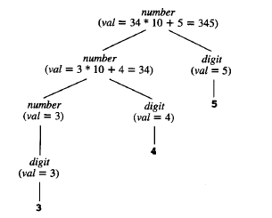

Slide 19
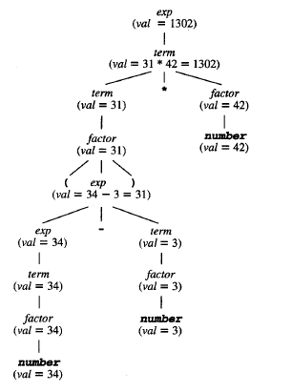

Slide 20
Chapter 5 Syntax-Directed Translation
5.1 Syntax-Directed Definitions
5、Inherited Attributes
Expressing the dependence of a programming language construction on the context in which it appears.
Notes: 1)By keeping track of the context whether an identifier appears on the left or right side of an assignment context we can decide whether the address or the value of the identifier is needed.

Slide 21
Chapter 5 Syntax-Directed Translation
5.1 Syntax-Directed Definitions
5、Inherited Attributes
Notes: 2)Although it is always possible to rewrite a syntax-directed definition to use only synthesized attributes, it is often natural to use syntax-directed definition with inherited attributes.

Slide 22
E.g. Syntax-directed definition with inherited attribute L.in
Production | Semantic rules
D →T L | L.in=T.type
T →int | T.type= integer
T →real | T.type=real
L →L ⁽¹⁾,id | L ⁽¹⁾.in=L.in addtype(id.entry, L.in)
L → id | addtype(id.entry, L.in)

Slide 23
E.g. Parse tree with inherited attribute in at each node labeled L. (real id1,id2,id3)
D
T.type=real L.in=real
real L.in=real , id3
L.in=real , id2
id1

Slide 24
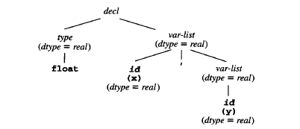

Slide 25
Chapter 5 Syntax-Directed Translation
5.1 Syntax-Directed Definitions
6、Dependency graphs
1)Definition
  A directed graph that describes the inter-dependencies among the inherited and synthesized attributes at the nodes in a parse tree
  2)Constructing a dependency graph for a given parse tree

Slide 26
for each node n in the parse tree do
for each attribute a of the grammar symbol at n do
construct a node in the dependency graph for a;
for each node n in the parse tree do
for each semantic rule b=f(c1,c2,……,ck)
associated with the production used at n do
for (i=1, i<=k ,i++)
construct an edge from the node for ci to the node for b;

Slide 27
Chapter 5 Syntax-Directed Translation
5.1 Syntax-Directed Definitions
6、Dependency graphs
2) Constructing a dependency graph for a given parse tree
E.g. when the following production is used in a parse tree, construct the dependency graph.
Production | Semantic rules
E →E ⁽¹⁾ + E⁽²⁾ | E.val= E⁽¹⁾.val+E⁽²⁾.val

Slide 28
E
•val
E⁽¹⁾ + E⁽²⁾
Val val
The three nodes of the dependency graph marked by • represent the synthesized attributes E.val, E⁽¹⁾.val, and E⁽²⁾.val at the corresponding nodes in the parse tree.
The dotted lines represent the parse tree and are not part of the dependency graph.

Slide 29

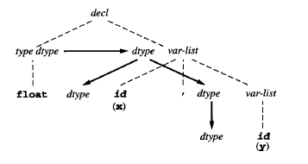

Slide 30
Chapter 5 Syntax-Directed Translation
5.1 Syntax-Directed Definitions
7、 Evaluation order
  1) Basic idea
  In the topological sort of a DAG

Slide 31
Chapter 5 Syntax-Directed Translation
5.1 Syntax-Directed Definitions
7、 Evaluation order
  2)Topological sort of a DAG
  Any ordering m1,m2,…,mk of the nodes of the graph such that edges go from nodes earlier in the ordering to later nodes.
    Notes: From a topological sort of a dependency graph, we obtain an evaluation order for the semantic rules.

Slide 32
Chapter 5 Syntax-Directed Translation
5.1 Syntax-Directed Definitions
7、 Evaluation order
  3)An example

Slide 33
D
T type 4 in 5 L 6
real in 7 L 8 , id3 3 entry
In 9 L 10 , id2 2 entry
id1 1 entry

Slide 34
From this topological sort, we obtain the following program.(ai for the attribute associated with the node numbered i in the dependency graph.)
  a4=real;
  a5=a4;
  Addtype (id3.entry, a5);
  a7=a5;
  Addtype (id2.entry, a7);
  a9=a7;
  Addtype (id1.entry, a9);

Slide 35
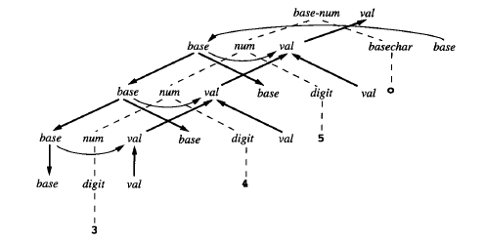

Slide 36
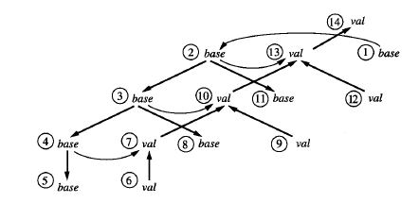

Slide 37
Chapter 5 Syntax-Directed Translation
5.1 Syntax-Directed Definitions
7、 Evaluation order
4)Methods for evaluating semantic rules
    (1)Parse-tree methods
    Obtain an evaluation order from a topological sort of the dependency graph constructed from the parse tree for each input.
    Notes: It will fail if the dependency graph for the particular parse tree has a cycle.

Slide 38
Chapter 5 Syntax-Directed Translation
5.1 Syntax-Directed Definitions
7、 Evaluation order
4)Methods for evaluating semantic rules
(2)Rule-based methods
    At compiler-construction time, the semantic rules associated with productions are analyzed.
    Notes: For each production, the order is predetermined .

Slide 39
Chapter 5 Syntax-Directed Translation
5.1 Syntax-Directed Definitions
7、 Evaluation order
4)Methods for evaluating semantic rules
(3)Oblivious methods
    An evaluation order is chosen without considering the semantic rules.
    Note. Its order restricts the class of syntax-directed definitions that can be implemented.

Slide 40
Chapter 5 Syntax-Directed Translation
5.1 Syntax-Directed Definitions
7、 Evaluation order
4)Methods for evaluating semantic rules
Notes: Rule-based and oblivious methods need not explicitly construct the dependency graph at compiler time, so they can be more efficient in their use of compiler time and space

Slide 41
Chapter 5 Syntax-Directed Translation
5.2 Directed Acyclic Graphs for Expressions
  a DAG for an expression identifies the common sub-expressions in the expression.
  E.g. A DAG for the expression
  a+a*(b-c)+(b-c)*d

Slide 42
+
+ *
* d
a -
b c

Slide 43
Chapter 5 Syntax-Directed Translation
5.2 Directed Acyclic Graphs for Expressions
How to use syntax-directed definitions to specify translations
  Bottom-up evaluation of the S-attributed definitions
  Top-down translation of L-attributed definitions

Slide 44
Chapter 5 Syntax-Directed Translation
5.2 Directed Acyclic Graphs for Expressions
L-attributed Definition
A syntax-directed definition is L-attributed if each inherited attribute of X_{j},1<=j<=n, on the right side of A →X₁X₂…X_{n}, depends only on
  1)The attributes of the symbols X₁,X₂,…X_{j-1} to the left of X_{j} in the production and
  2)The inherited attributes of A.

Slide 45
Chapter 5 Syntax-Directed Translation
5.2 Directed Acyclic Graphs for Expressions
L-attributed Definition
Note: 1) L-attributes can always be evaluated in depth-first order
2) “L” means “left”, because L-attribute information appears to flow from left to right
3)Every S-attributed definition is L-attributed, because the restrictions in the definition apply only to inherited attributes.

Slide 46
Chapter 5 Syntax-Directed Translation
5.3 Bottom-up evaluation of the S-attributed definitions
1、Basic idea
  Evaluated by a bottom-up parser as the input is being parsed.
  The parser keeps the values of the synthesized attributes associated with the grammar symbols on its stack.

Slide 47
Chapter 5 Syntax-Directed Translation
5.3 Bottom-up evaluation of the S-attributed definitions
1、Basic idea
  When a reduction is made, the values of the new synthesized attributes are computed from the attributes appearing on the stack for the grammar symbols on the right side of the reducing production.

Slide 48
Chapter 5 Syntax-Directed Translation
5.3 Bottom-up evaluation of the S-attributed definitions
1、Basic idea
  Notes: 1)A translator for an S-attributed definition can often be implemented with an LR-parser
  2)The stack is used to hold information about sub-trees that have been parsed.
  3)We can use extra fields in the parser stack to hold the values of synthesized attributes

Slide 49
Chapter 5 Syntax-Directed Translation
5.3 Bottom-up evaluation of the S-attributed definitions
1、Basic idea
  E.g.
State | Val
… | …
X | X.val
Y | Y.val
… | …

Slide 50
Chapter 5 Syntax-Directed Translation
5.3 Bottom-up evaluation of the S-attributed definitions
2、Evaluating the Synthesized attributes
Production | Code fragment
L →E# | Print(val[top])
E →E ⁽¹⁾ + T | Val[ntop]= val[top-2]+val[top]
E →T
T→T ⁽¹⁾*F | Val[ntop]= val[top-2]*val[top]
T →F
F→(E) | Val[ntop]= val[top-1]
F → digit

Slide 51
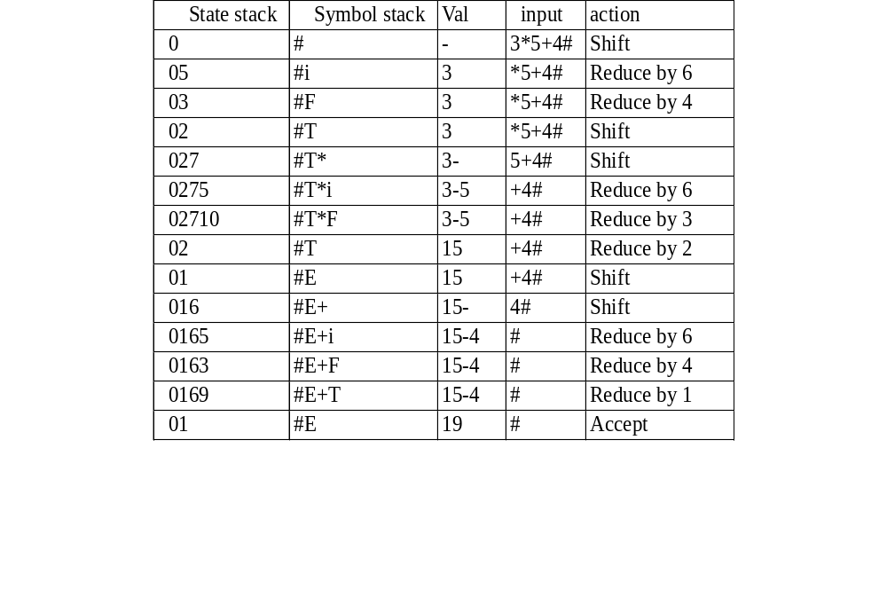
Moves made by translator on 3*5+4#

Slide 52
Chapter 5 Syntax-Directed Translation
5.4 Translation schemes
1、Definition
A context-free grammar in which attributes are associated with the grammar symbols and semantic actions enclosed between braces {} are inserted within the right sides of productions.
Notes: 1)Translation schemes is a useful notation for specifying translation during parsing.
2)The type of the attributes here can be synthesized attribute or inherited attribute

Slide 53
Chapter 5 Syntax-Directed Translation
5.4 Translation schemes
2、An example
Maps infix expressions with addition and subtraction into corresponding postfix expressions.
  E →TR
  R →addop T {print (addop.lexeme)} R⁽¹⁾|ε
  T →num {print (num.val)}

Slide 54
The parse tree with translate schemes for the input 9-5+2.
E
T R
9 {print(‘9’)} - T {print(‘-’)} R
5 {print(‘5’)} + T {print(‘+’)} R
2 {print(‘2’)} ε
Notes: 1)Here, actions are considered as terminal symbols
2)By depth-first order traverse ,we can get the sequence
9 5 - 2 +

Slide 55
Chapter 5 Syntax-Directed Translation
5.4 Translation schemes
3、 Rules on a translation scheme design
  Some restrictions should be observed to ensure that an attribute value is available when an action refers to it
  The restrictions can be motivated by L-attributed definitions

Slide 56
Chapter 5 Syntax-Directed Translation
5.4 Translation schemes
3 、 Rules on a translation scheme design
3) When only synthesized attributes are needed, construct the translation scheme by creating an action consisting of an assignment for each semantic rule, and placing this action at the end of the right side of the associated production.

Slide 57
E.g. Production Semantic Rule
T →T₁*F T.val= T₁.val*F.val
So yield the following production and semantic action
T →T₁*F{ T.val= T₁.val*F.val}

Slide 58
Chapter 5 Syntax-Directed Translation
5.4 Translation schemes
3 、 Rules on a translation scheme design
4) When both inherited and synthesized attributes are needed
  An inherited attribute for a symbol on the right side of a production must be computed in an action before that symbol.
  An action must not refer to a synthesized attribute of a symbol to the right of the action.

Slide 59
Chapter 5 Syntax-Directed Translation
5.4 Translation schemes
3 、 Rules on a translation scheme design
4) When both inherited and synthesized attributes are needed
A synthesized attribute for the non-terminal on the left can only be computed after all attributes it references have been computed.The action computing such attributes can usually be placed at the end of the right side of the production

Slide 60
Production Semantic Rules
S→B B.ps=10
S.ht=B.ht
B →B₁B₂ B₁.ps=B.ps
B₂.ps=B.ps
B.ht=max(B₁.ht,B₂.ht)
Syntax-directed definition
S →{B.ps=10}B{S.ht=B.ht}
B →{B₁.ps=B.ps}B₁{B₂.ps=B.ps}B₂{B.ht=max(B₁.ht,B₂.ht)}
Related Translation scheme

Slide 61
Chapter 5 Syntax-Directed Translation
5.5 Top-down translation
1、Basic idea
Use L-attributed definition and translation schemes during predictive parsing
Extend the algorithm for eliminating left recursion to a translation schemes with synthesized attributes.

Slide 62
Chapter 5 Syntax-Directed Translation
5.5 Top-down translation
2、Eliminating Left Recursion from a Translation Scheme
Extend the algorithm for eliminating left recursion to allow for attributes when the underlying grammar of a translation schemes with synthesized attributes is transformed

Slide 63
Chapter 5 Syntax-Directed Translation
5.5 Top-down translation
2、Eliminating Left Recursion from a Translation Scheme
E.g. Translation scheme with left-recursive grammar
  E →E₁+T {E.val=E₁.val+T.val}
  E →E₁-T {E.val=E₁.val-T.val}
  E →T {E.val=T.val}
  T →(E) {T.val=E.val}
  T →num {T.val=num.val}

Slide 64
Transformed translation scheme with right-recursive grammar
  E →T {R.i=T.val}
  R {E.val=R.s}
  R →+
  T {R₁.i=R.i+T.val}
  R₁ {R.s=R₁.s}
  R →-
  T {R₁.i=R.i-T.val}
  R₁ {R.s=R₁.s}
  Notes: “s” means synthesized attribute,”i” means inherited attribute

Slide 65
Transformed translation scheme with right-recursive grammar
  R →ε {R.s=R.i}
  T →(
  E
  ) {T.val=E.val}
  T →num {T.val=num.val}
  Notes: “s” means synthesized attribute,”i” means inherited attribute

Slide 66
Evaluation of the expression 9-5+2.
E
T.val=9 R.i=9
Num.val=9 - T.val=5 R.i=4
Num.val=5 + T.val=2 R.i=6
Num.val=2 ε

Slide 67
Stack Semantic actions Input String
E 9-5#
R T₁
R 9 T₁.val=9
R R.i=9 -5#
R₁ T₂ - -5#
R₁ T₂ 5#
R₁ 5 T₂.val=5
R₁ R₁.i=R.i-T₂.val=4
R₁.s=R₁.i=4
R.s= R₁.s=4
E.val=R.s=4

Slide 68
Chapter 5 Syntax-Directed Translation
5.5 Top-down translation
3、Algorithm for eliminating left recursion from a translation scheme with synthesized attribute
1)Suppose we have the following translation scheme
  A →A₁Y {A.a=g(A₁.a,Y.y)}
  A →X {A.a=f(X.x )}
  Notes: We assume here each grammar symbol has a synthesized attribute, and f and g are arbitrary functions.

Slide 69
Chapter 5 Syntax-Directed Translation
5.5 Top-down translation
3、Algorithm for eliminating left recursion from a translation scheme with synthesized attribute
2)After eliminating left recursion:
  A →XR
  R →YR|ε

Slide 70
Chapter 5 Syntax-Directed Translation
5.5 Top-down translation
3、Algorithm for eliminating left recursion from a translation scheme with synthesized attribute
3)Taking the semantic actions into account, the transformed scheme becomes:
  A →X {R.i=f(X.x)}
  R {A.a=R.s}
  R →Y {R₁.i=g(R.i, Y.y)}
  R₁ {R.s=R₁.s}
  R →ε {R.s=R.i}

Slide 71
A.a=g(g(f(X.x),Y₁.y),Y₂.y)
A.a=g(f(X.x),Y₁.y) Y₂
A.a=f(X.x) Y₁
X
One way of computing an attribute value

Slide 72
A
X R.i=f(X.x)
Y₁ R.i=g(f(X.x),Y₁.y)
Y₂ R.i=g(g(f(X.x),Y₁.y),Y₂.y)
ε
Another way of computing an attribute value

Slide 73
Chapter 5 Syntax-Directed Translation
5.5 Top-down translation
4、Design of a Predictive Translator
1) Basic idea
  A translation scheme based
  Modification of the predictive-parser

Slide 74
Chapter 5 Syntax-Directed Translation
5.5 Top-down translation
4、Design of a Predictive Translator
2) Algorithm
  (1)Input
  A syntax-directed translation scheme with an underlying grammar suitable for predictive parsing
(2)Output
Code for a syntax-directed translator

Slide 75
Chapter 5 Syntax-Directed Translation
5.5 Top-down translation
4、Design of a Predictive Translator
2) Algorithm
  (3)Method
  For each non-terminal A, construct a function that has a formal parameter for each inherited attribute of A and that returns the values of the synthesized attributes of A.
  Notes: We assume here that each non-terminal A has just one synthesized attribute.

Slide 76
Chapter 5 Syntax-Directed Translation
5.5 Top-down translation
4、Design of a Predictive Translator
2) Algorithm
  (3)Method
  The code for non-terminal A decides what production to use based on the current input symbol

Slide 77
Chapter 5 Syntax-Directed Translation
5.5 Top-down translation
4、Design of a Predictive Translator
2) Algorithm
  (3)Method
  The code associated with each production does the following:
    For token X with synthesized attribute x, save the value of x in the variable declared for X.x. Then generate a call to match token X and advance the input

Slide 78
Chapter 5 Syntax-Directed Translation
5.5 Top-down translation
4、Design of a Predictive Translator
2) Algorithm
  (3)Method
  The code associated with each production does the following:
    For non-terminal B, generate an assignment c=B(b₁,b₂,…,b_{k}) with a function call on the right side, where b₁,b₂,…,b_{k} are the variables for the inherited attributes of B and c is the variable for the synthesized attribute of B

Slide 79
Chapter 5 Syntax-Directed Translation
5.5 Top-down translation
4、Design of a Predictive Translator
2) Algorithm
  (3)Method
  The code associated with each production does the following:
    For an action , copy the code into the parser, replacing each reference to an attribute by the variable for that attribute

Slide 80
R→addop
T{R1.i=mknode(addop.lexeme,R.i,T.nptr)}
R1 {R.s=R1.s}
R→ε {R.s=R.i}
Node *R(i:*Node)
{
Node *nptr,i1,s1,s;
char addoplexeme;
if (lookahead==addop)
{
addoplexeme=lexval;
match(addop);
nptr=T();
i1=mknode(addoplexeme,i,nptr);
s1=R(i1);
s=s1
}
else s=i;
return(i)
}

Slide 81
Chapter 5 Syntax-Directed Translation
5.6 Bottom-up evaluation of inherited attributes
1、Basic idea
1)Implement L-attributed definitions in the framework of bottom-up parsing
2)Use a transformation that makes all embedded actions in a translation scheme occur at the right ends of their productions

Slide 82
Chapter 5 Syntax-Directed Translation
5.6 Bottom-up evaluation of inherited attributes
2、Removing embedding actions from translation schemes
1)Basic idea
    Insert new marker non-terminals generating ε into the base grammar
    Replace each embedded action by a distinct marker non-terminal M and attach the action to the end of the production M→ε

Slide 83
Chapter 5 Syntax-Directed Translation
5.6 Bottom-up evaluation of inherited attributes
2、Removing embedding actions from translation schemes
2)An example
  E →TR
  R →addop T {print (addop.lexeme)} R⁽¹⁾|ε
  T →num {print (num.val)}
➔ E →TR
  R →addop T M R⁽¹⁾|ε
  M → ε {print (addop.lexeme)}
  T →num {print (num.val)}

Slide 84
Chapter 5 Syntax-Directed Translation
5.6 Bottom-up evaluation of inherited attributes
3、Inheriting attributes on the Parser stack
1)Basic idea
    Use copy rule
    In the production A→XY, if inherited attributed Y.i is defined by the copy rule Y.i=X.s , then the value X.s can be used where Y.i is called for

Slide 85
Chapter 5 Syntax-Directed Translation
5.6 Bottom-up evaluation of inherited attributes
3、Inheriting attributes on the Parser stack
2)An example

Slide 86
D
T type 4 in 5 L 6
real in 7 L 8 , id3 3 entry
In 9 L 10 , id2 2 entry
id1 1 entry

Slide 87
D→T {L.in=T.type} L
T →int {T.type=integer}
T →real {T.type=real}
L →{L₁.in=L.in}L₁,id {addtype(id.entry,L.in}
L →id {addtype(id.entry,L.in}
Production Code Fragment
D →T L
T →int val[ntop]=integer
T →real val[ntop]=real
L →L,id addtype(val[top],val[top-3]
L →id addtype(val[top],val[top-1]

Slide 88
Chapter 5 Syntax-Directed Translation
5.6 Bottom-up evaluation of inherited attributes
4、Simulating the evaluation of inherited attributes
1)Basic idea
Insert new marker non-terminal M into the right side of the related production
S→bABC {C.i=A.s}
=> S →bABMC {M.i=A.s;C.i=M.s}
M →ε {M.s=M.i}

Slide 89
Chapter 5 Syntax-Directed Translation
5.6 Bottom-up evaluation of inherited attributes
4、Simulating the evaluation of inherited attributes
2)Algorithm for bottom-up parsing and translation with inherited attributes
(1)Input
An L-attributed definition with an underlying LL(1) grammar
(2)Output
A parser that computes the values of all attributes on its parsing stack

Slide 90
Chapter 5 Syntax-Directed Translation
5.6 Bottom-up evaluation of inherited attributes
4、Simulating the evaluation of inherited attributes
2)Algorithm for bottom-up parsing and translation with inherited attributes
(3)Method
    Assume each non-terminal A has only one inherited attribute, every grammar symbol X has a synthesized attribute

Slide 91
Chapter 5 Syntax-Directed Translation
5.6 Bottom-up evaluation of inherited attributes
4、Simulating the evaluation of inherited attributes
2)Algorithm for bottom-up parsing and translation with inherited attributes
(3)Method
    For every production A→X₁..X_{n} , introduce n new marker non-terminals M₁,..,M_{n}, and replace the production by A → M₁X₁…M_{n}X_{n}. The X_{j.s} will go on the parser stack in the val array entry associated with X_{j}. The X_{j.i},if there is one, appears in the same array, but associated with M_{j}.
    Notes: X_{j.i} is computed at M_{j} before we begin the reduction to X_{j}.

Slide 92
Chapter 5 Syntax-Directed Translation
5.6 Bottom-up evaluation of inherited attributes
5、Replacing inherited by synthesized attributes
By changing the underlying grammar
D →L:T {L.type=T.type}
T →integer|char {T.type=integer|char}
L →L1,id {L1.type=L.type;addtype(id.entry,L.type)
L → id {addtype(id.entry,L.type)}
➔D →id L {addtype(id.entry,L.type)}
L →,id L1 {L.type=L1.type;addtype(id.entry,L1.type)}
L → :T {L.type=T.type}
T →integer|char {T.type=integer|char}

